Slide 1
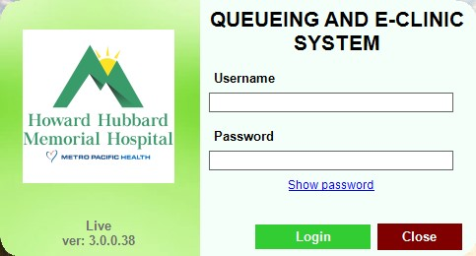
QUEUING MANAGEMENT SYSTEM

Slide 2
SELF QUEUING KIOSK
(DOLE PATIENT / GUARANTEED PATIENT)

Slide 3
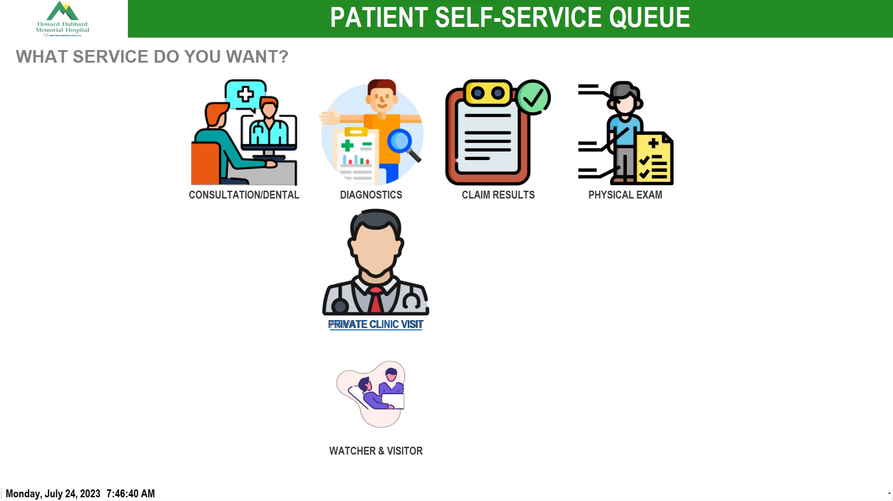
PATIENT WILL CHOOSE TRANSACTION

Slide 4
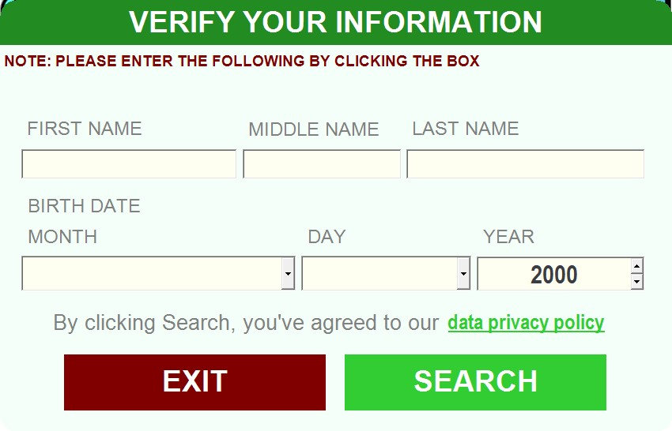
PATIENT WILL ENCODE DETAILS
THE CLICK SEARCH

Slide 5
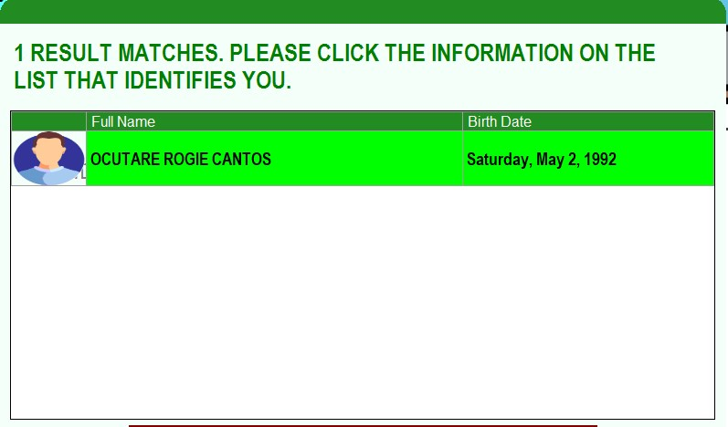
DOUBLE CLICK THE NAME

Slide 6
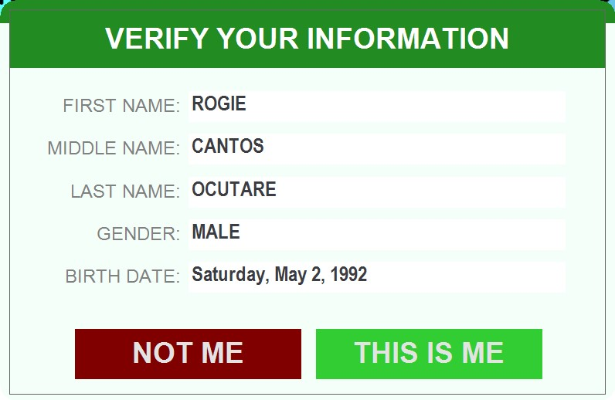
CONFIRMING IF THE DATA IS CORRECT

Slide 7
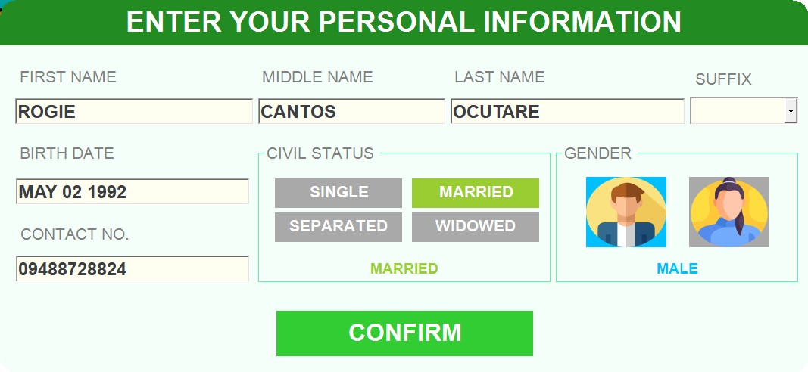
IF PATIENT’S DATA HAS CORRECTION THEY CAN EDIT IT THEN CLICK CONFIRM

Slide 8
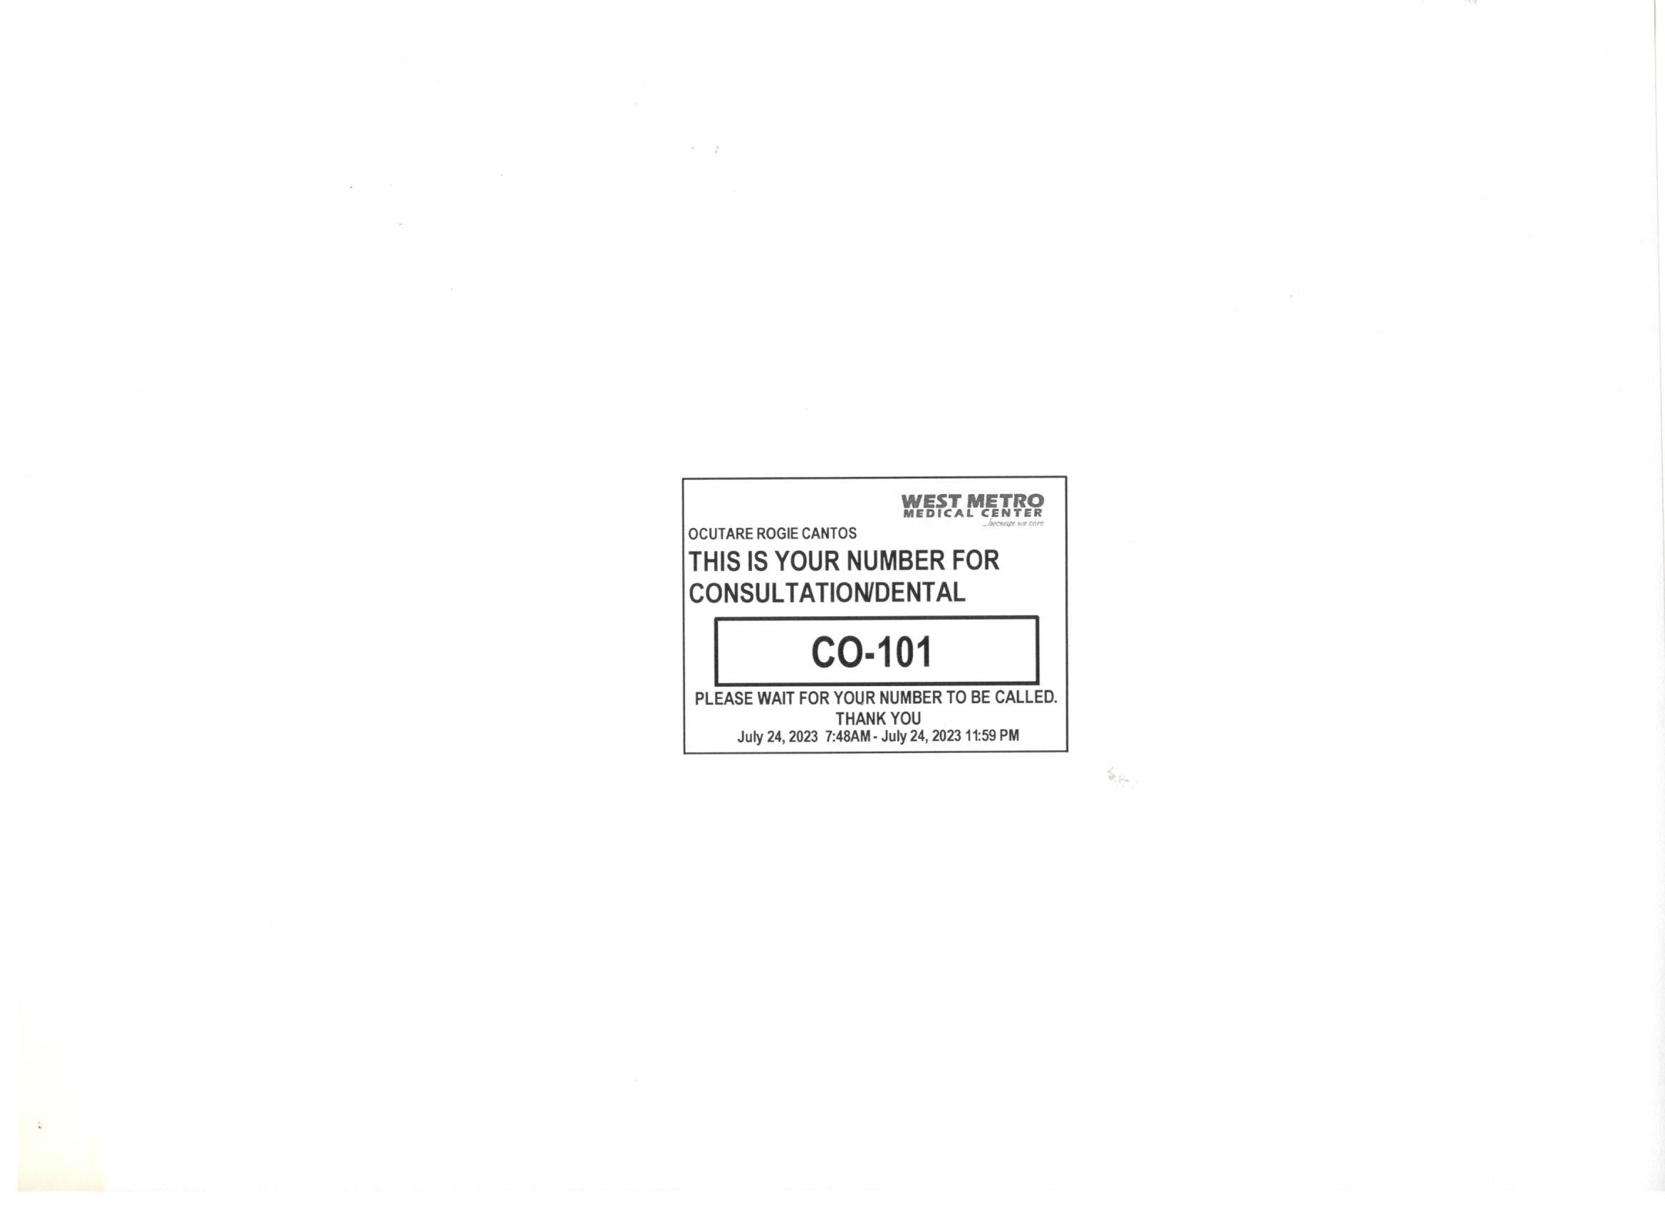
A PRINTED NUMBER WILL BE GENERATED

Slide 9
REGISTRATION AREA

Slide 10
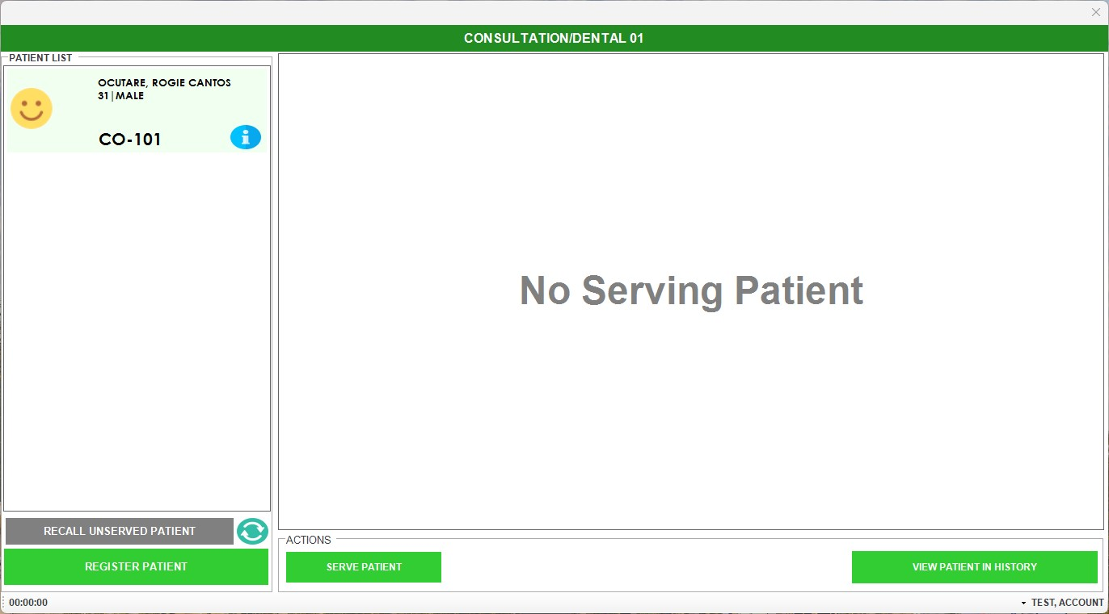
ENCODER WILL SERVE THE PATIENT
Note: There will be a tune to hear and Queue number will appear on the TV

Slide 11
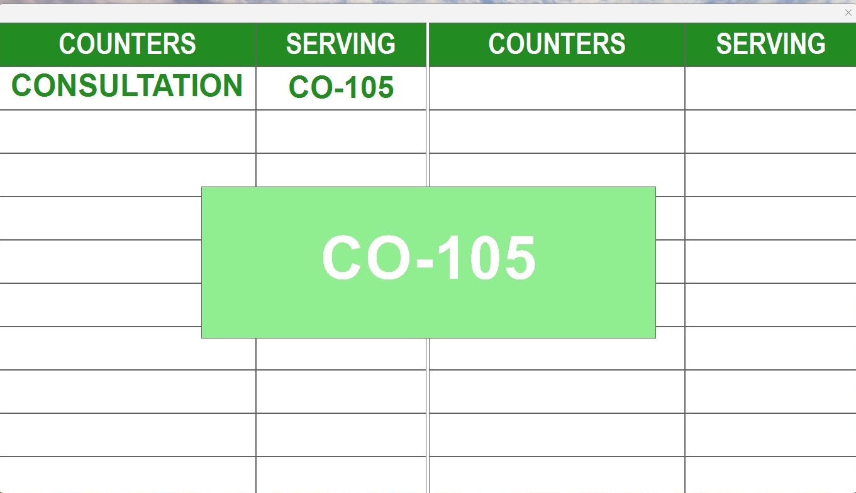
Note: There will be a tune to hear and Queue number will appear on the TV

Slide 12
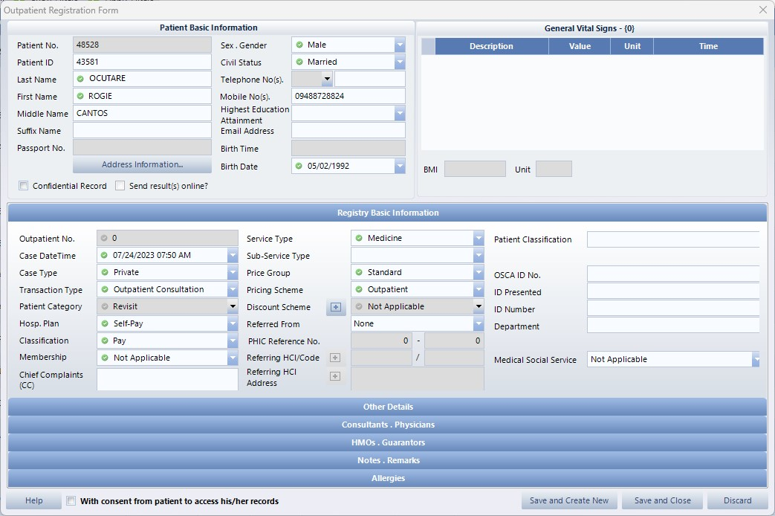
ENCODER WILL ENCODE PATIENT TO HIS

Slide 13
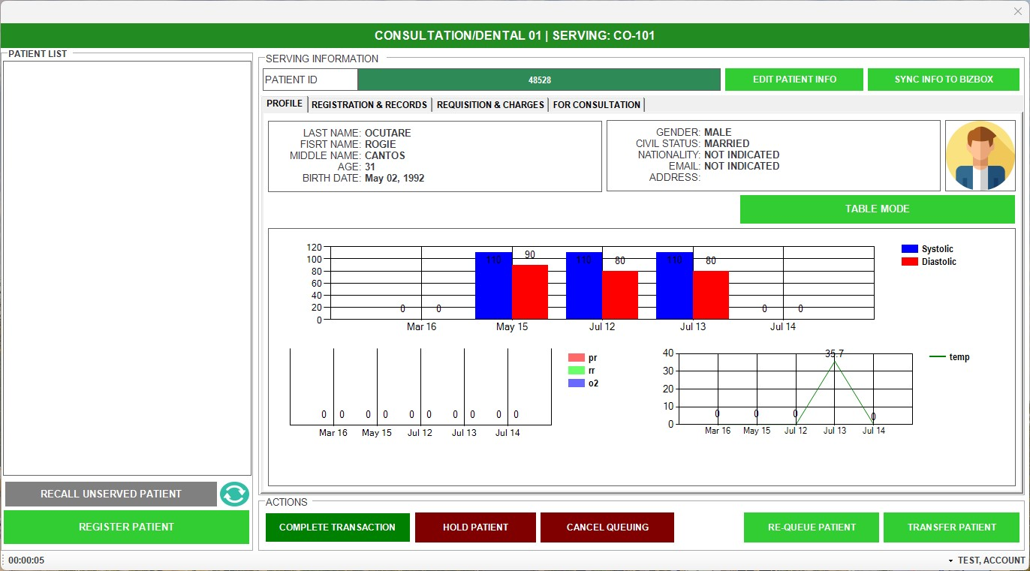
ENCODER WILL CLICK REGISTRATION & RECORDS

Slide 14
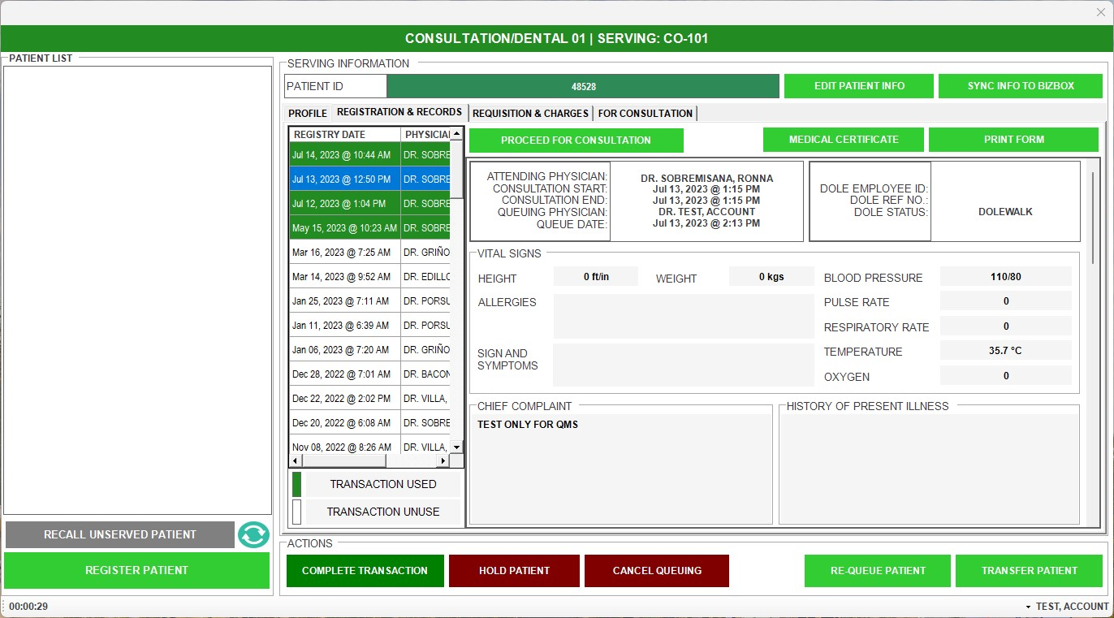
ENCODER WILL CLICK PROCEED FOR CONSULTATION

Slide 15
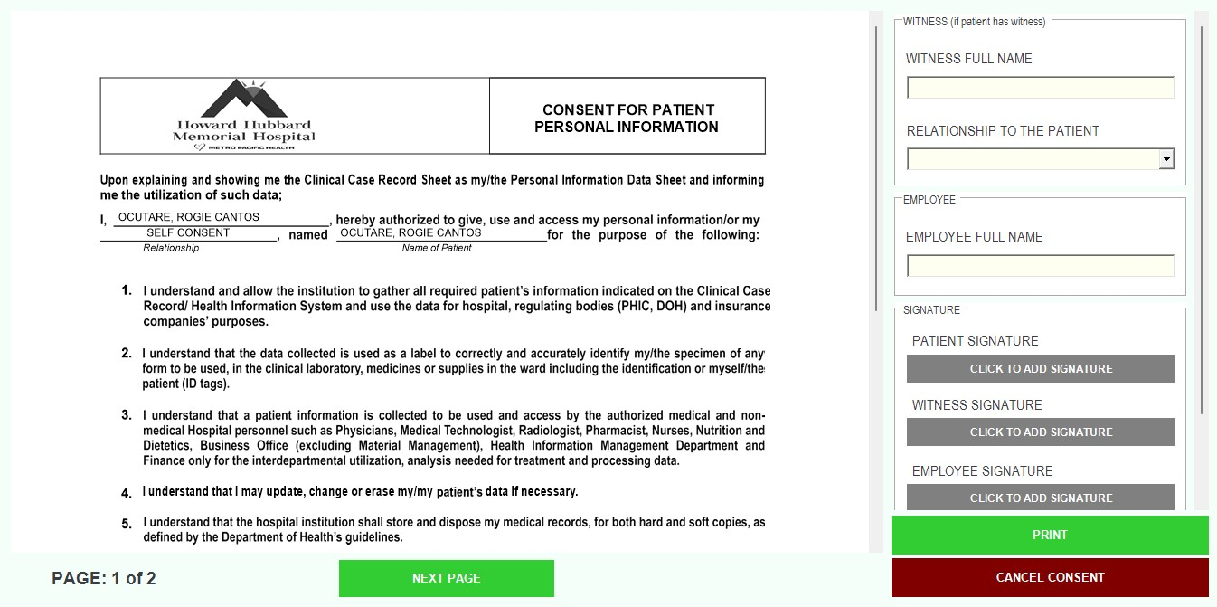
ENCODER WILL ASK THE PATIENT FOR CONSENT SIGNATURE AND CLICK ADD SIGNATURE

Slide 16
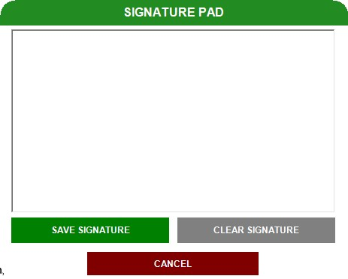
THE PATIENT WILL SIGN ON THE SIGNATURE PAD

Slide 17
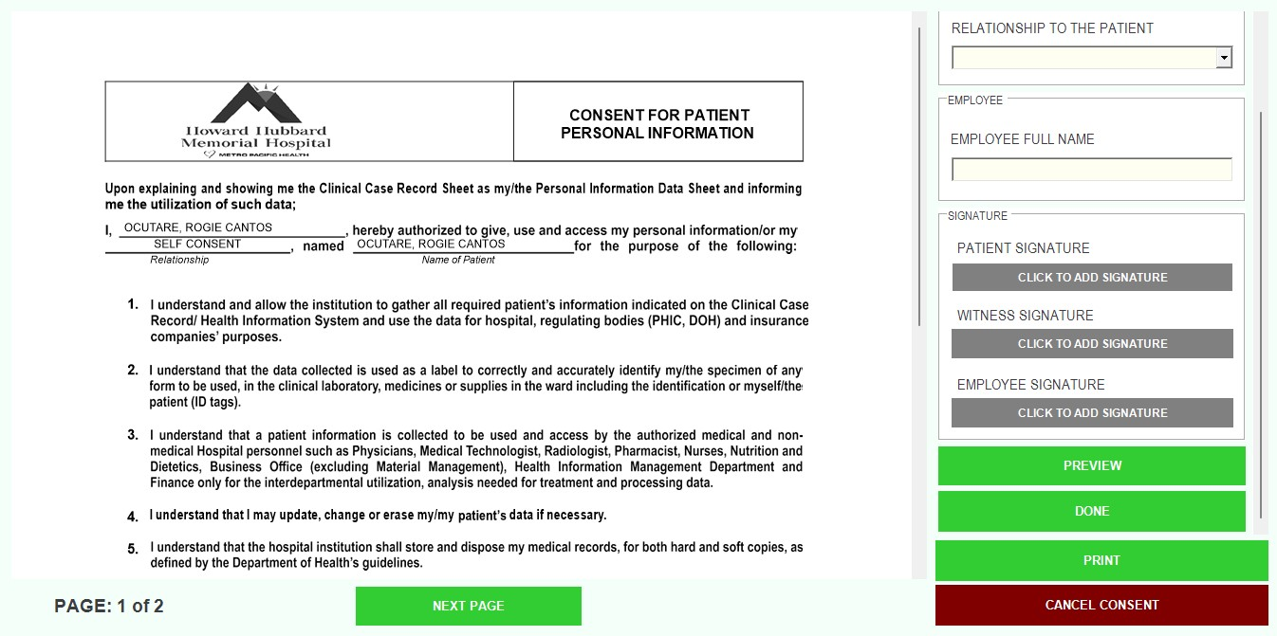
AFTER THE SIGNATURE IS ATTACHED ENCODER WILL CLICK DONE

Slide 18
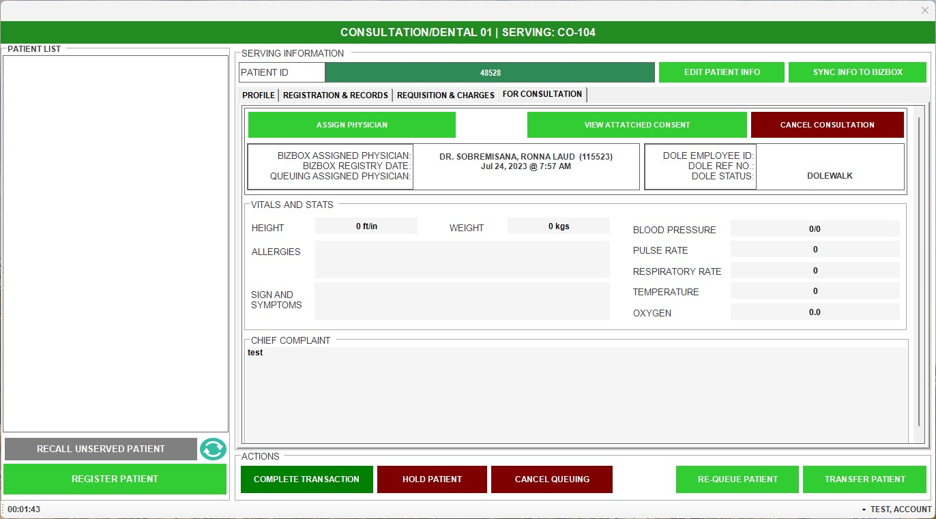
ENCODER THEN WILL ASSIGN QUEUEING ASSIGNED PHYSICIAN

Slide 19
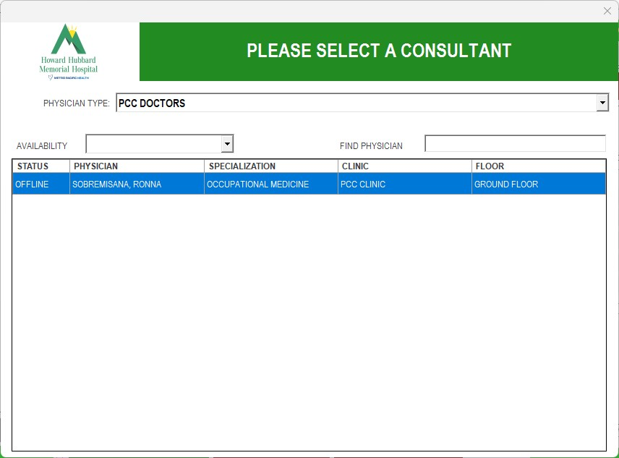
ENCODER THEN WILL SELECT THE PHYSICIAN

Slide 20
ENCODER THEN WILL TRANSFER PATIENT TO THE PHYSICIAN CLINIC

Slide 21
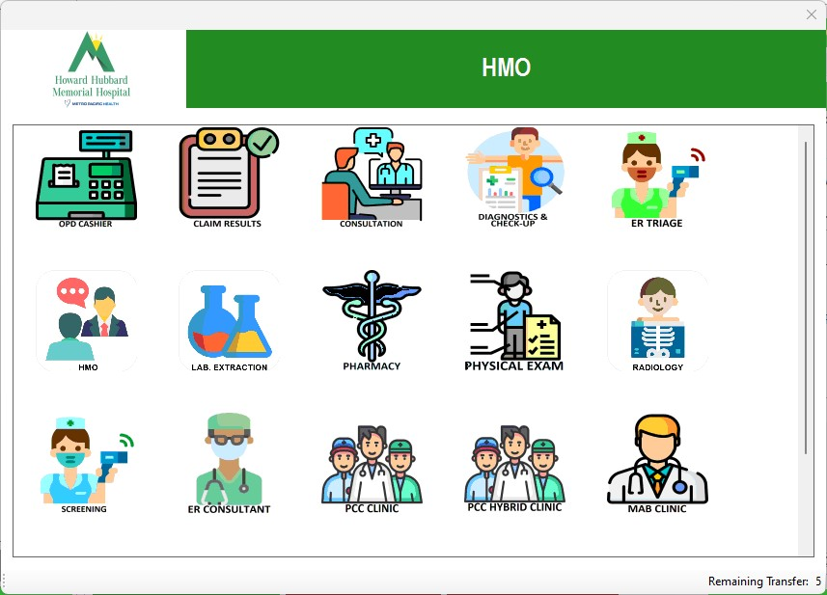

Slide 22
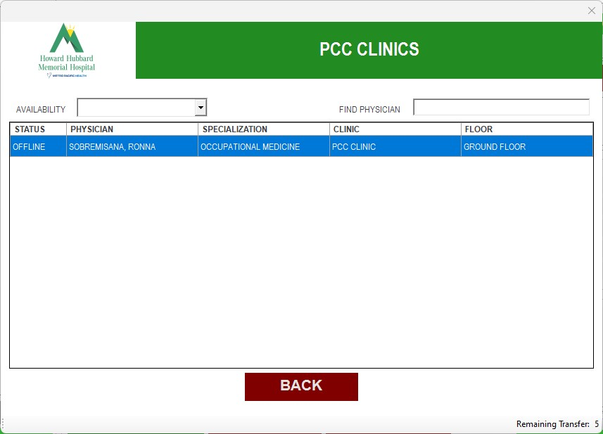
THEN SELECT THE NAME OF THE PHYSICIAN

Slide 23
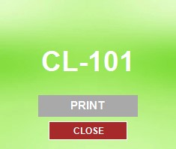
QMS THEN WILL GENERATE PRINTED TICKET

Slide 24
DOCTORS MODULE

Slide 25
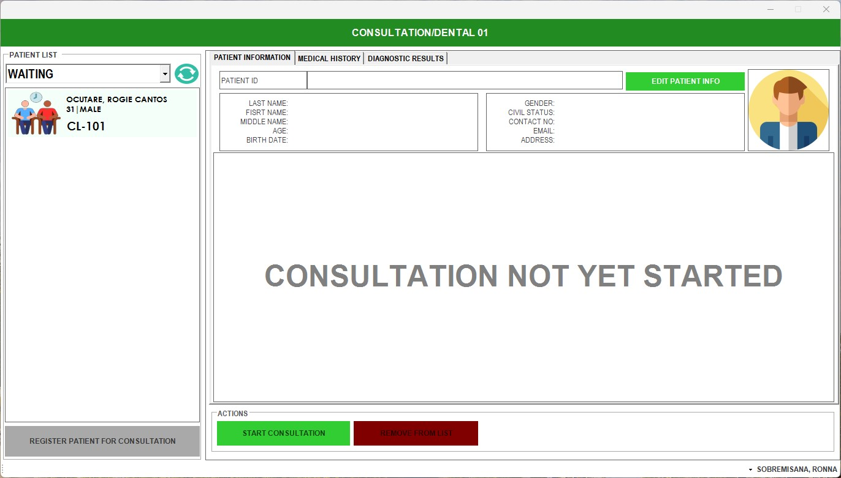
DOCTOR WILL SEE IF THERE ARE PATIENTS WAITING, THEN SERVE IF READY. THEY WILL CLICK THE NAME WITH THE LATEST NUMBER THEN CLICK START CONSULTATION

Slide 26
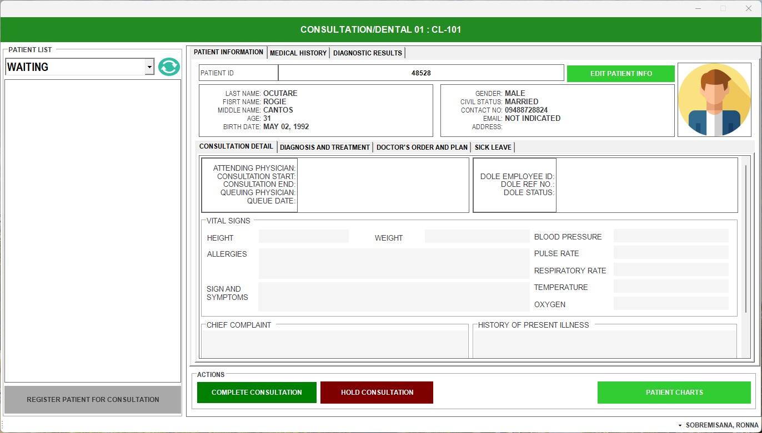
AFTER SERVING THIS WOULD BE THE APPEARANCE, THEN THE PATIENT WILL GIVE THE PRINTED NUMBER TO THE DOCTOR

Slide 27
THE DOCTOR WILL OPEN ELECTRONIC MEDICAL RECORDS (EMR)

Slide 28
THEN THE DOCTOR WILL INPUT ALL THE SOAP & SICKLEAVE IN EMR.

Slide 29
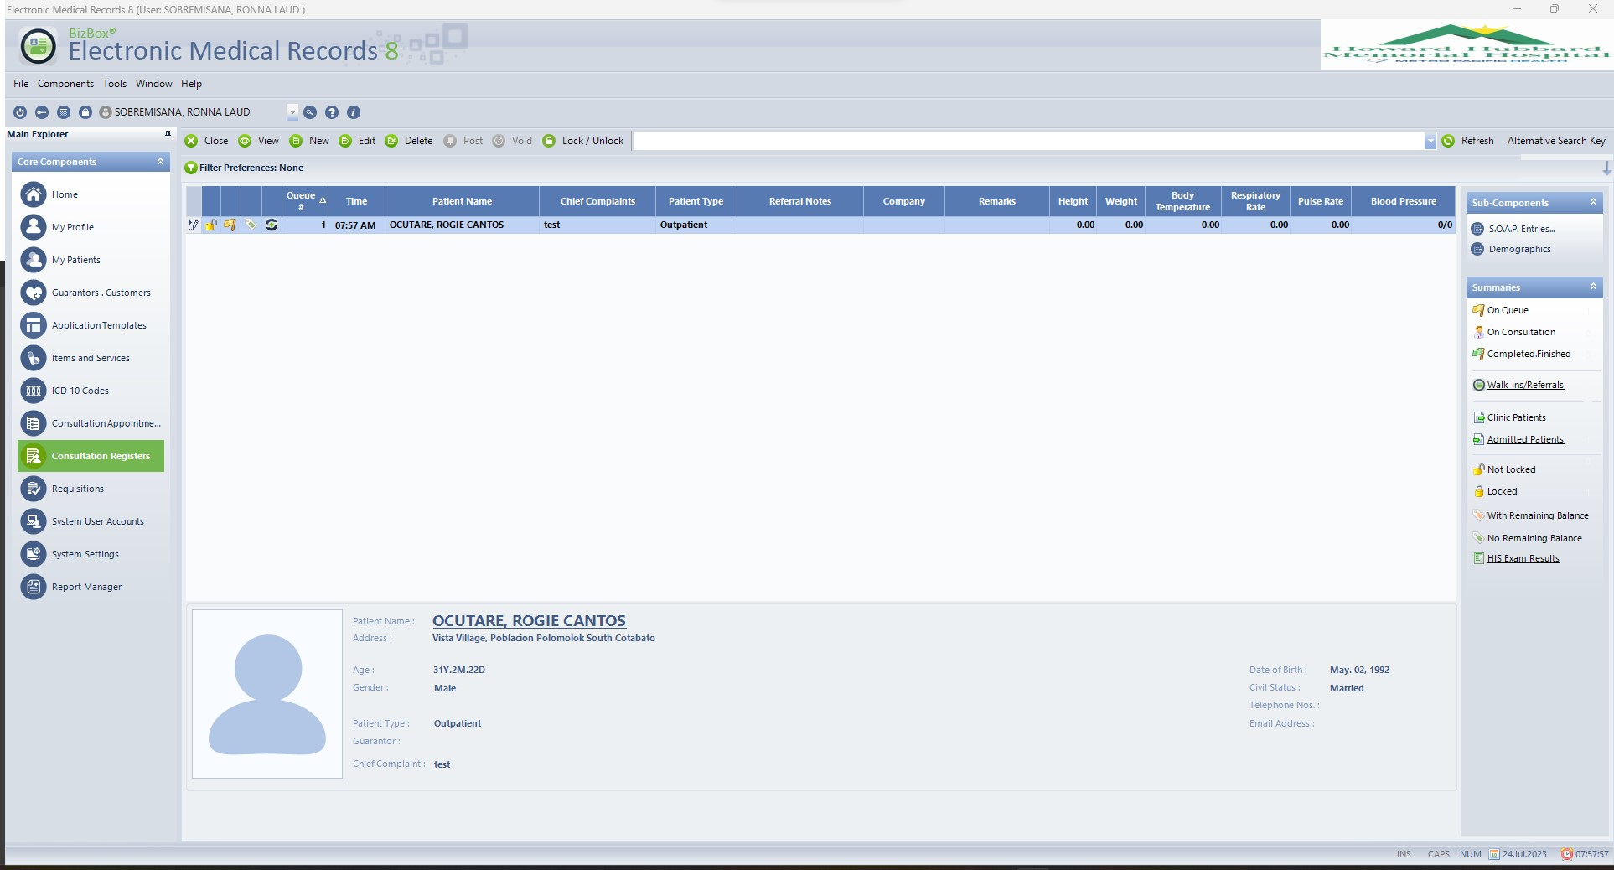
CLICK PATIENTS NAME THE CLICK S.O.A.P. ENTRIES

Slide 30
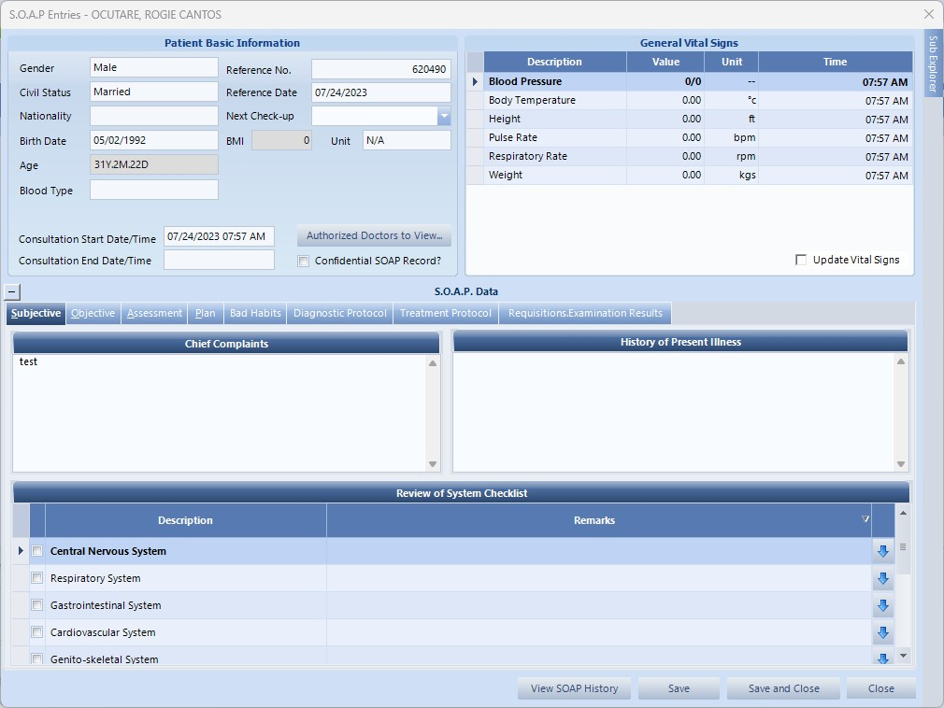
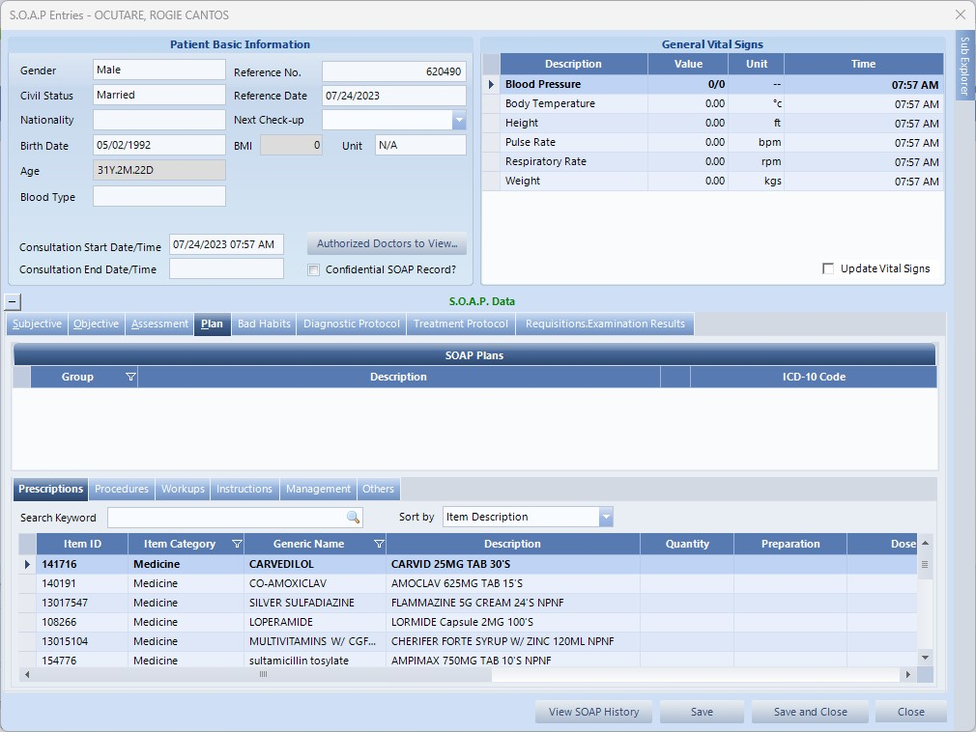
THEN THE DOCTOR WILL INPUT THE S.O.A.P. ENTRIES

Slide 31
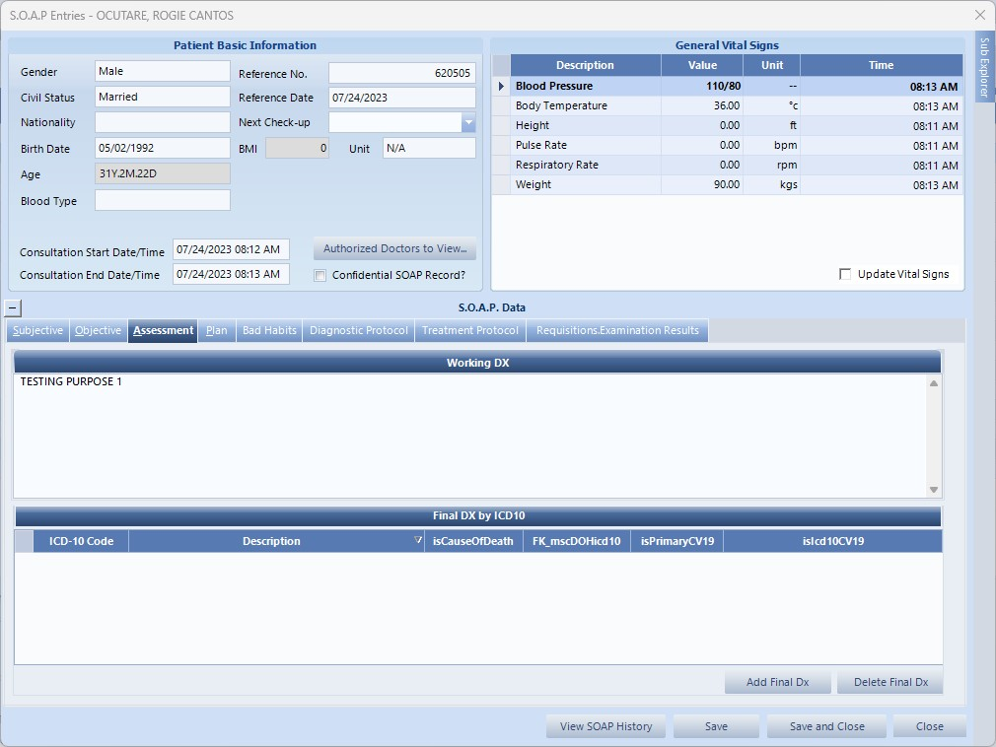
AFTER PUTTING ASSESSMENT, PLEASE ADD FINAL DIAGNOSIS

Slide 32
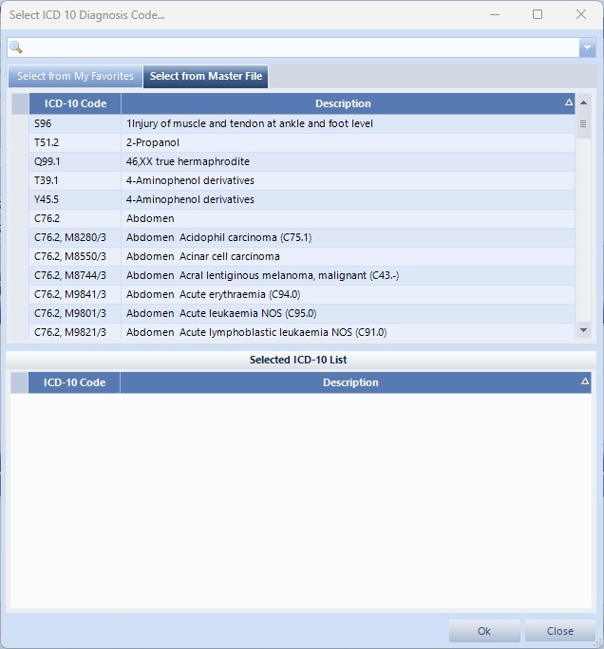
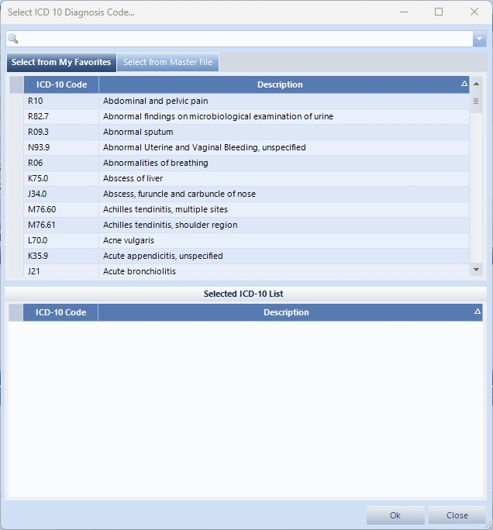
SEARCH THE FINAL DIAGNOSIS VIA ICD-10 CODE OR DESCRIPTION

Slide 33
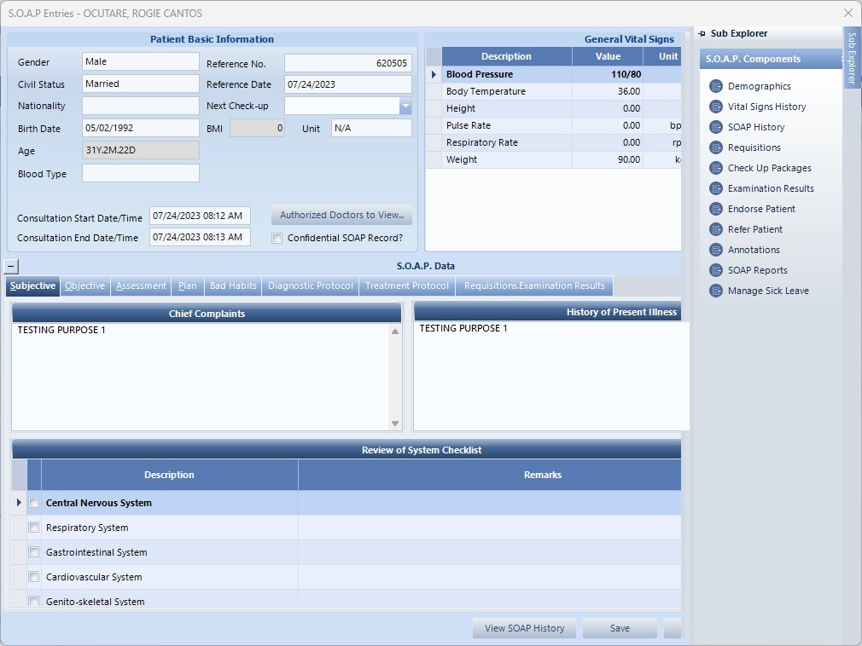
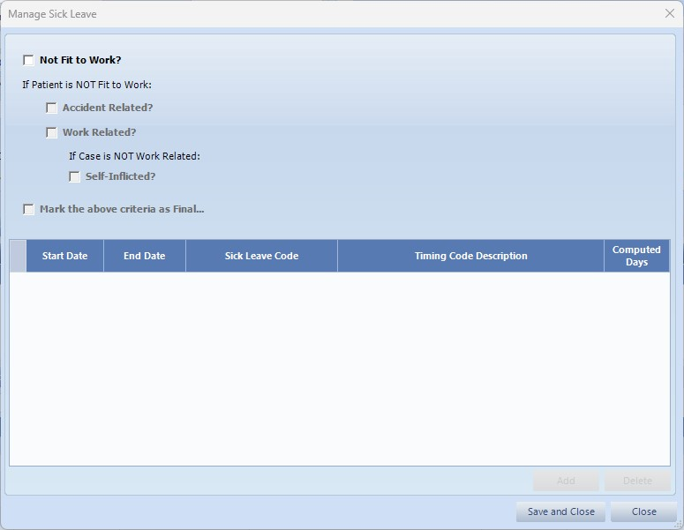
AND IF DOLE EMPLOYEES, PLEASE DON’T FORGET TO PUT THE SICKLEAVE OF THE PATIENT
THEN CLICK SAVE AND CLOSE

Slide 34
THEN IF THE DOCTOR ORDERED DIAGNOSTICS & MEDICINES, OPEN HIS FOR REQUISITIONS.

Slide 35
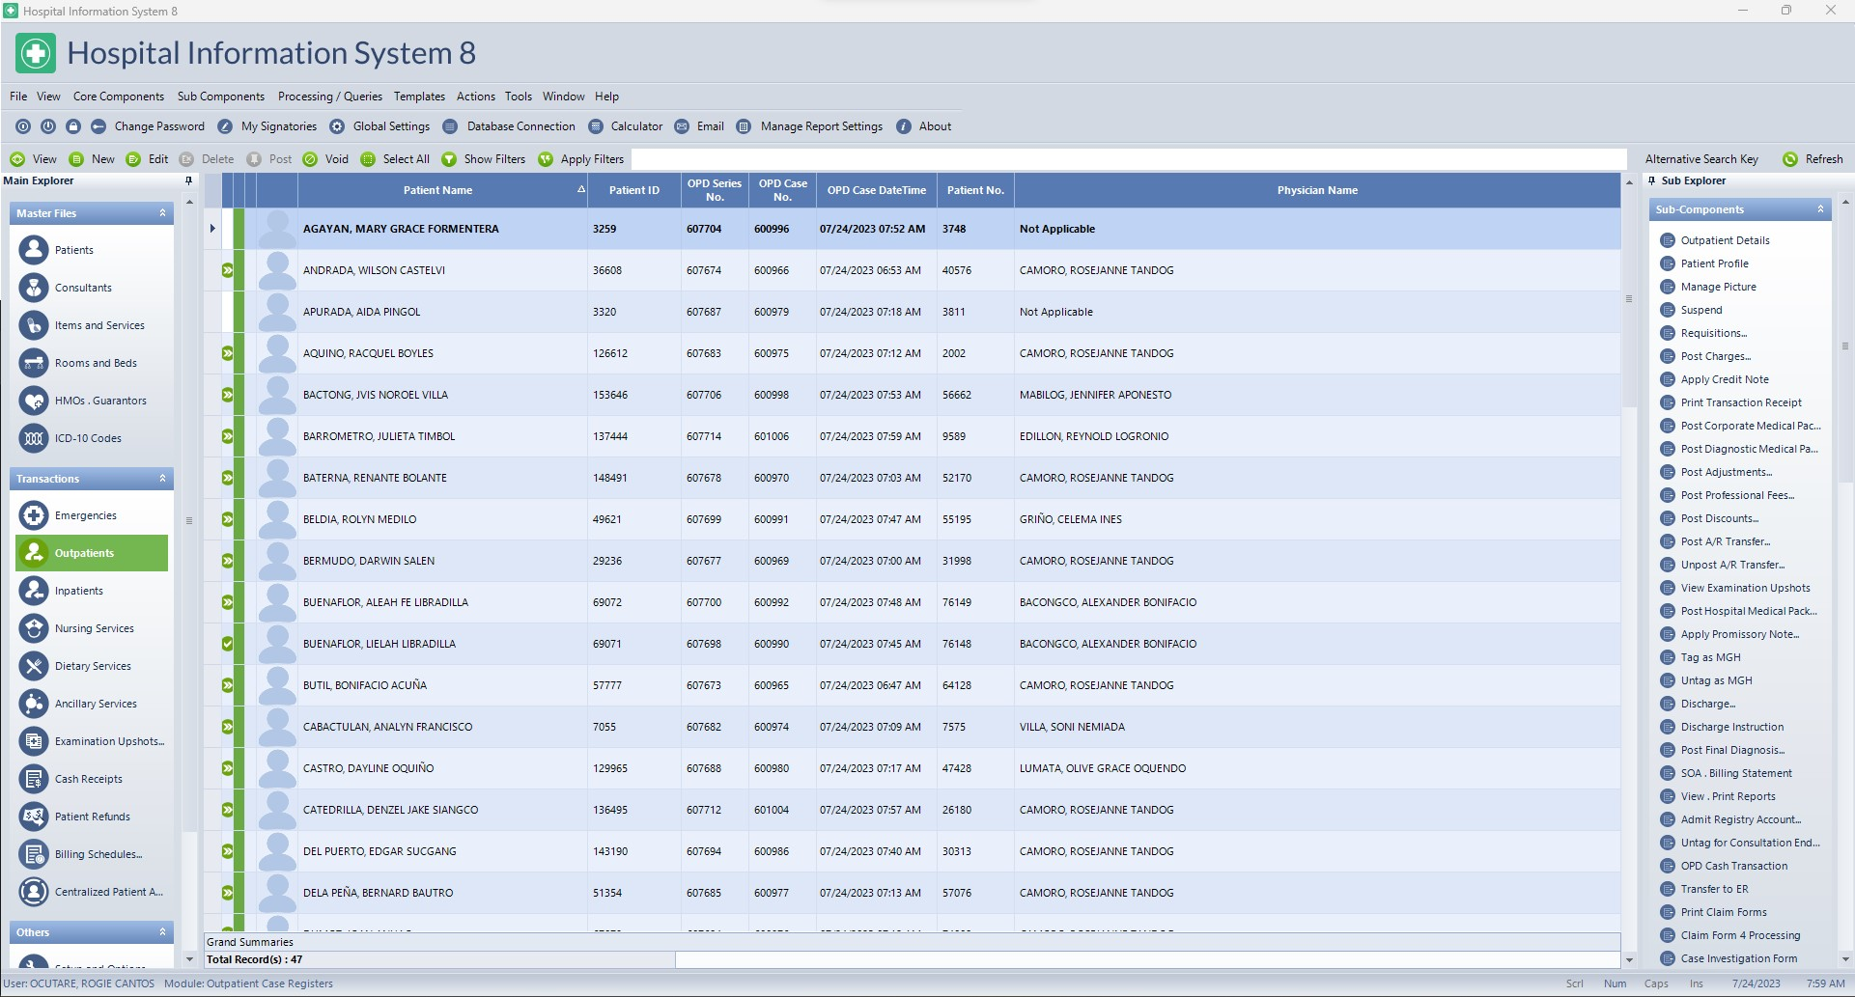
OPEN OUTPATIENT MODULE, FIND THE PATIENT THEN CLICK REQUISITIONS

Slide 36
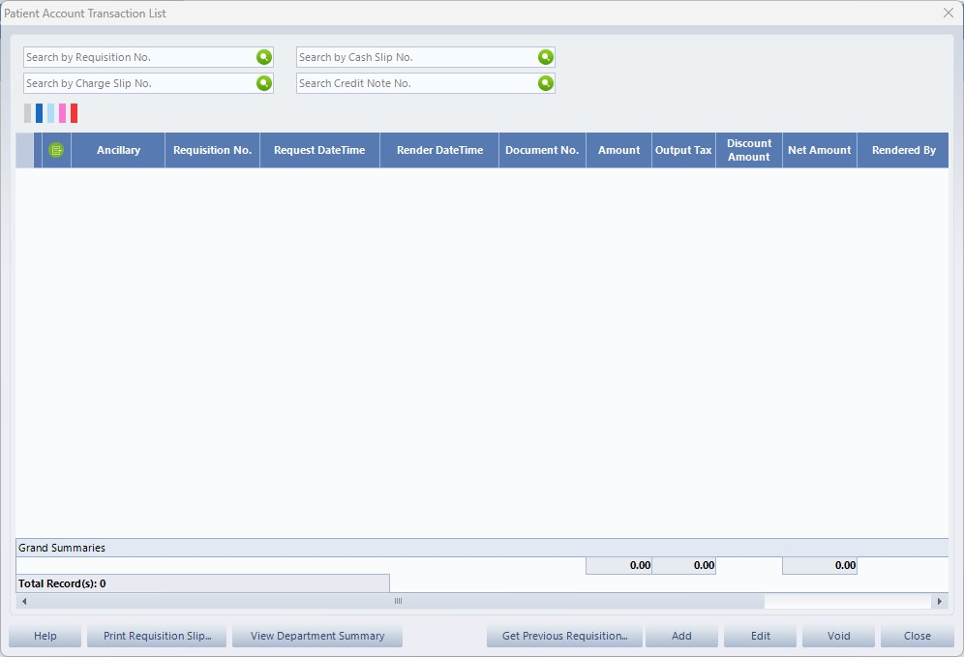
OPEN OUTPATIENT MODULE, FIND THE PATIENT, CLICK REQUISITIONS THEN CLICK ADD

Slide 37
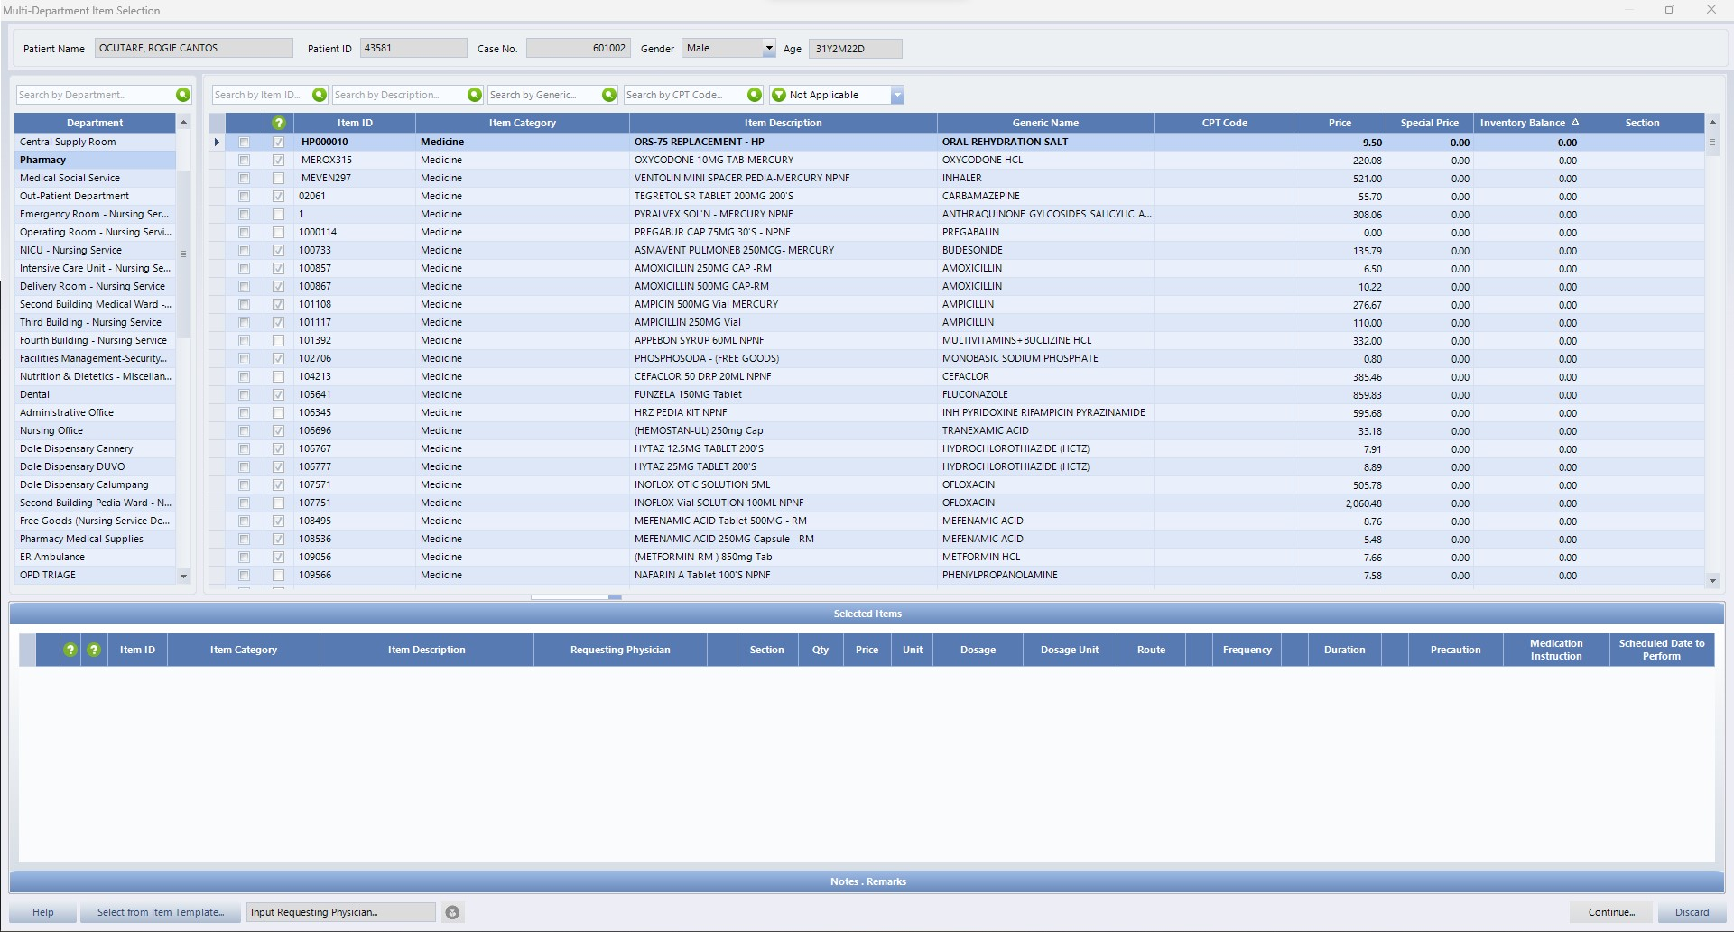
IF MEDS CLICK PHARMACY, IF DIAGNOSTICS CLICK LABORATORY & RADIOLOGY. CLICK SEARCH BY DESCRIPTION THEN SEARCH THE DESIRED ITEM.

Slide 38
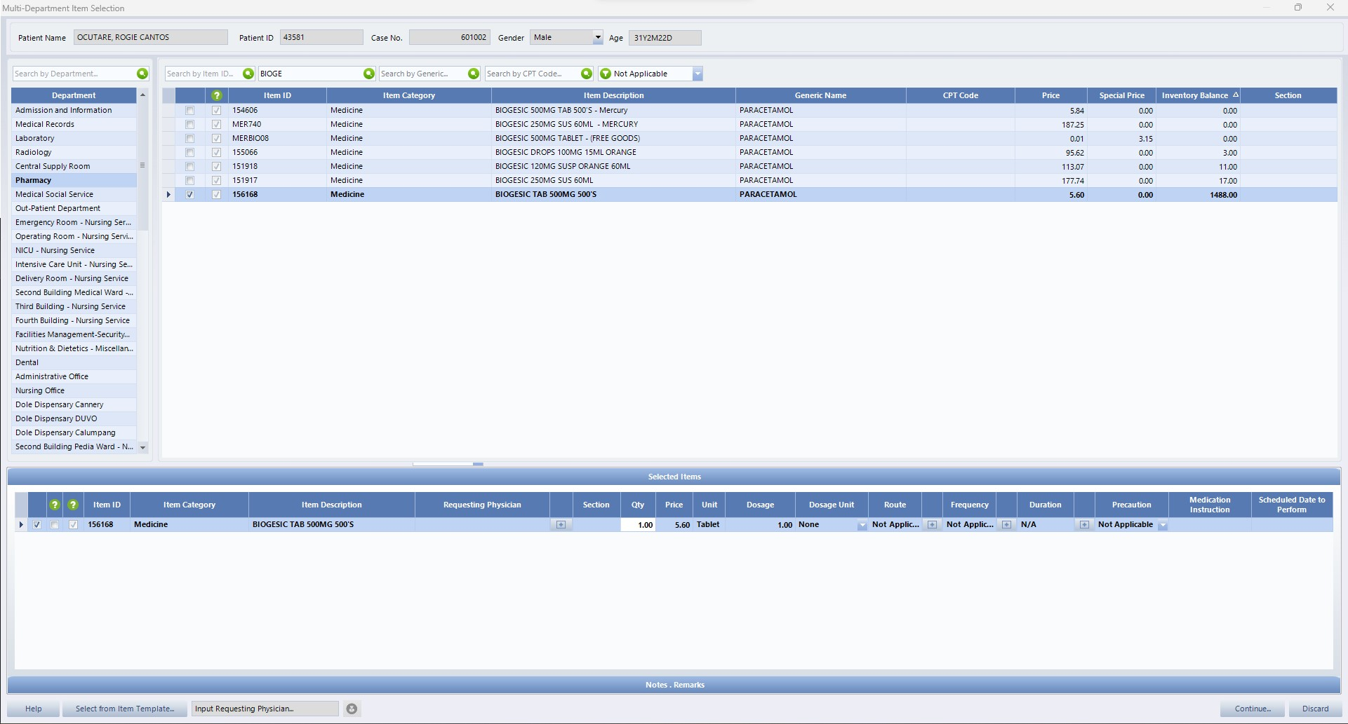
SAMPLE 1. THE ORDER IS BIOGESIC, SEARCH BIOGESIC. THEN ADD THE QUANTITY AND CLICK CONTINUE

Slide 39
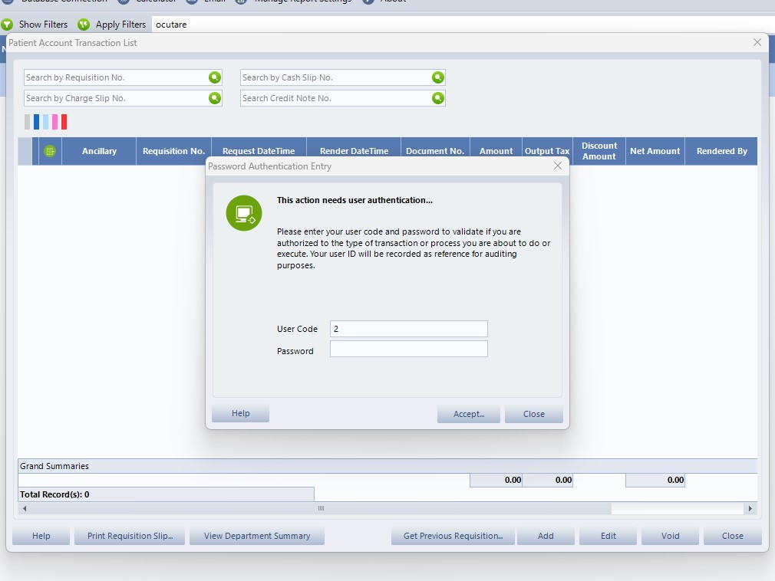
THEN INPUT PASSWORD TO CONFIRM TRANSACTION

Slide 40
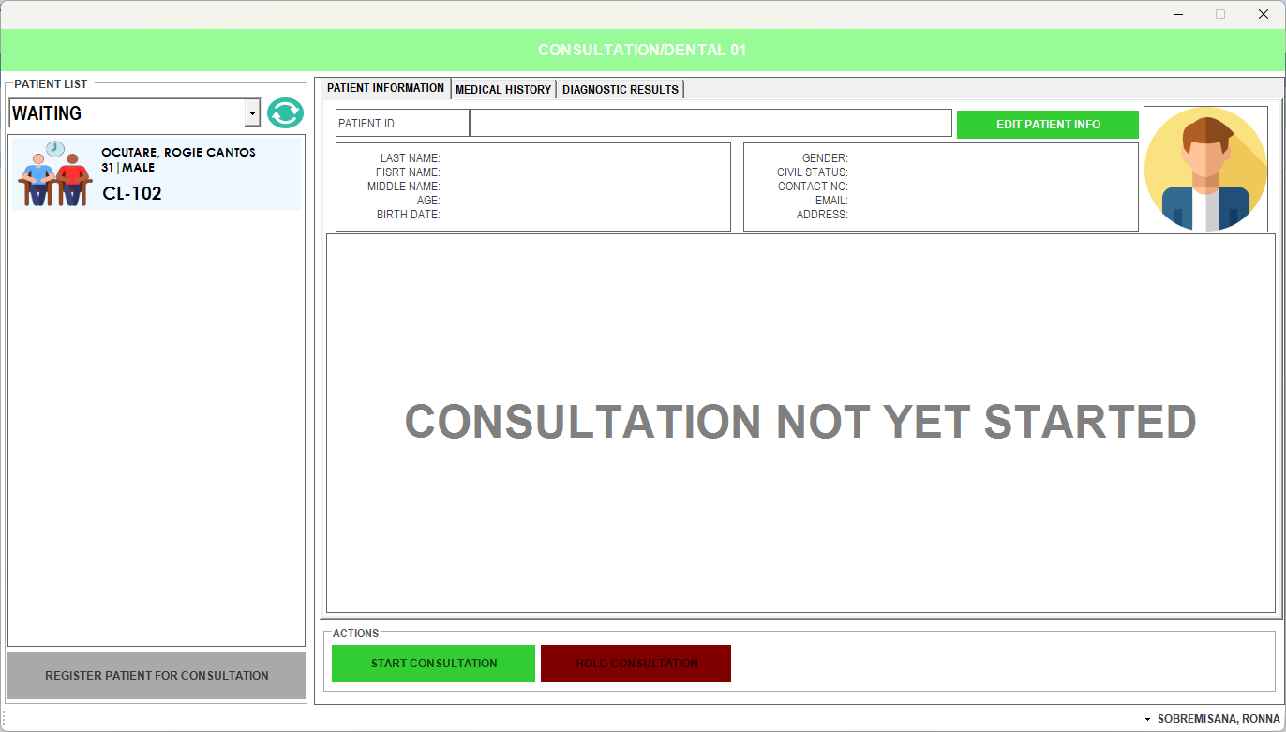
THE DOCTOR WILL GO BACK TO QMS THEN CLICK REFRESH TO SEE THE DATA ENCODED AT EMR

Slide 41
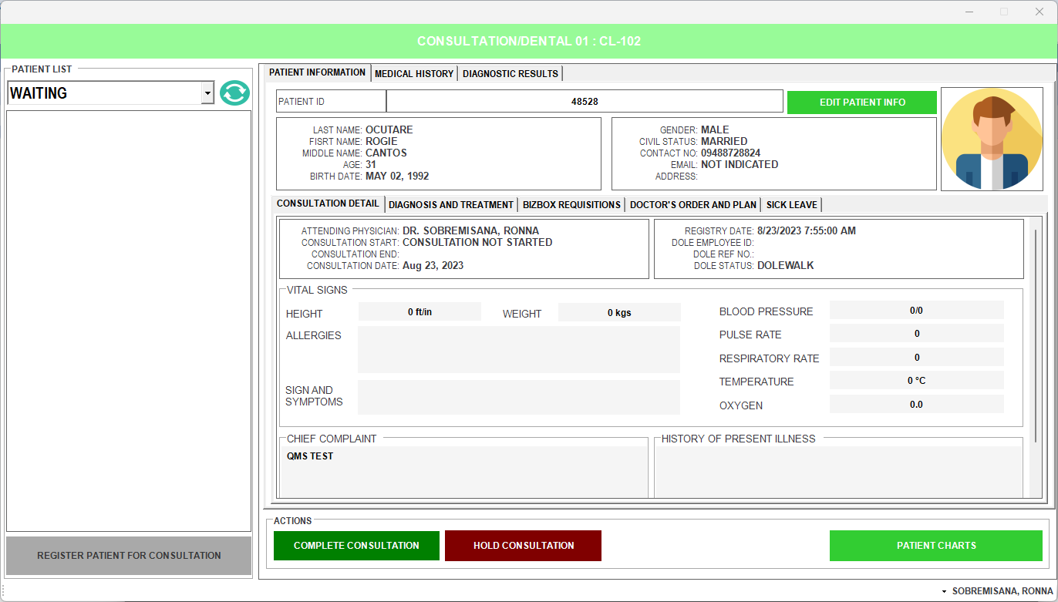

Slide 42
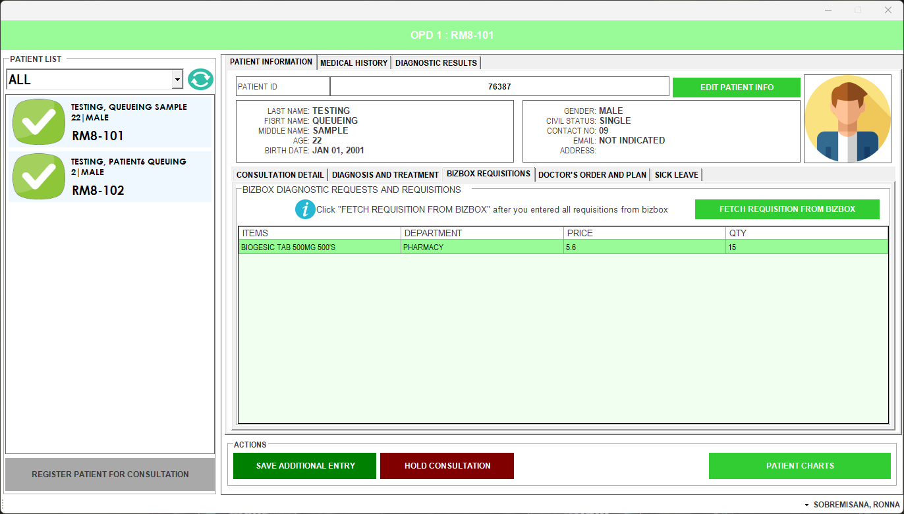

Slide 43
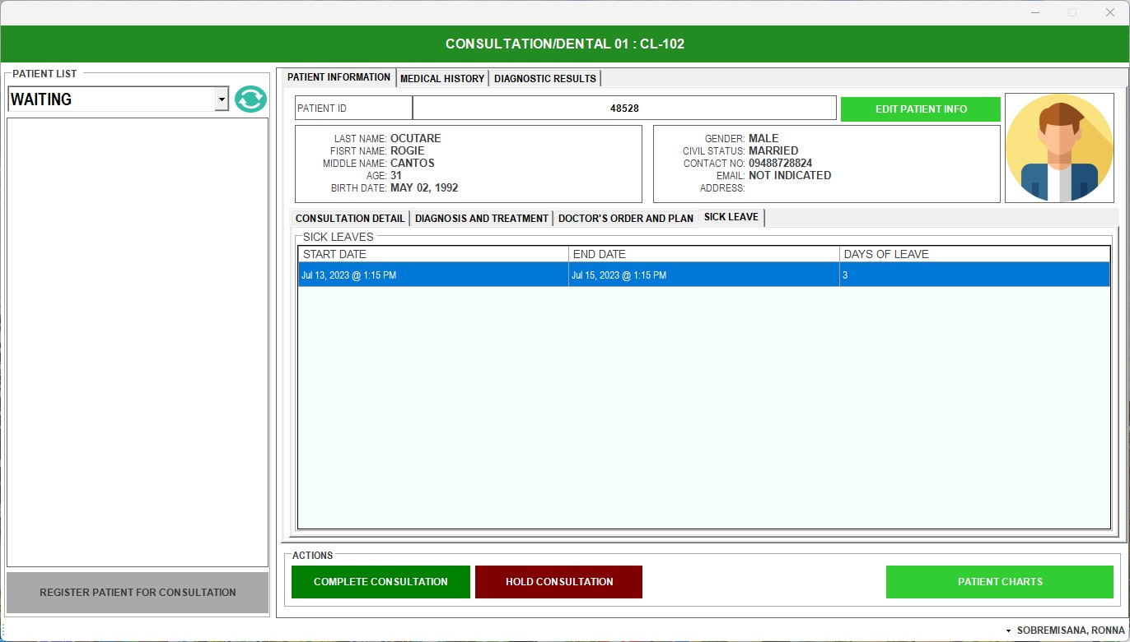

Slide 44
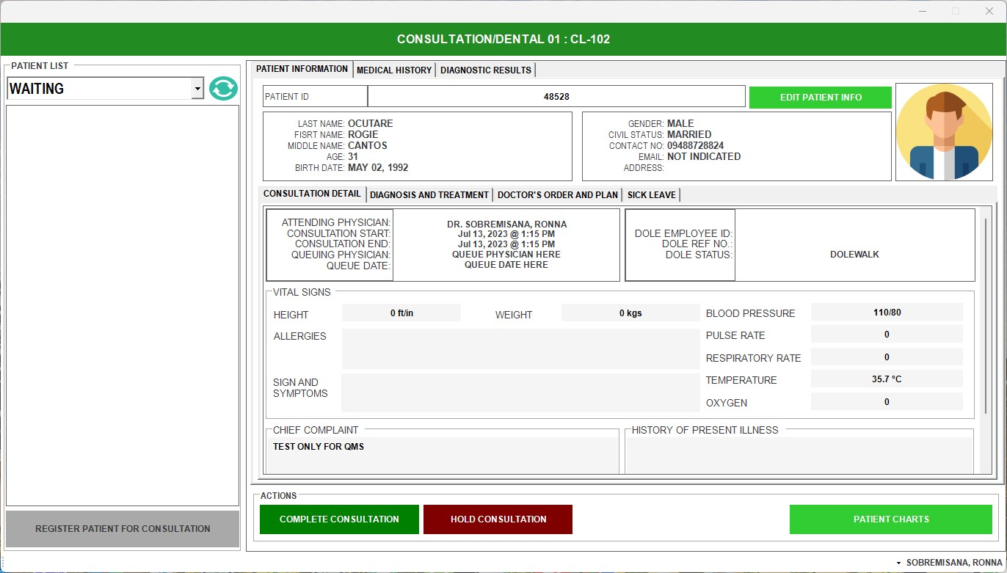
THEN INPUT PASSWORD TO CONFIRM TRANSACTION

Slide 45
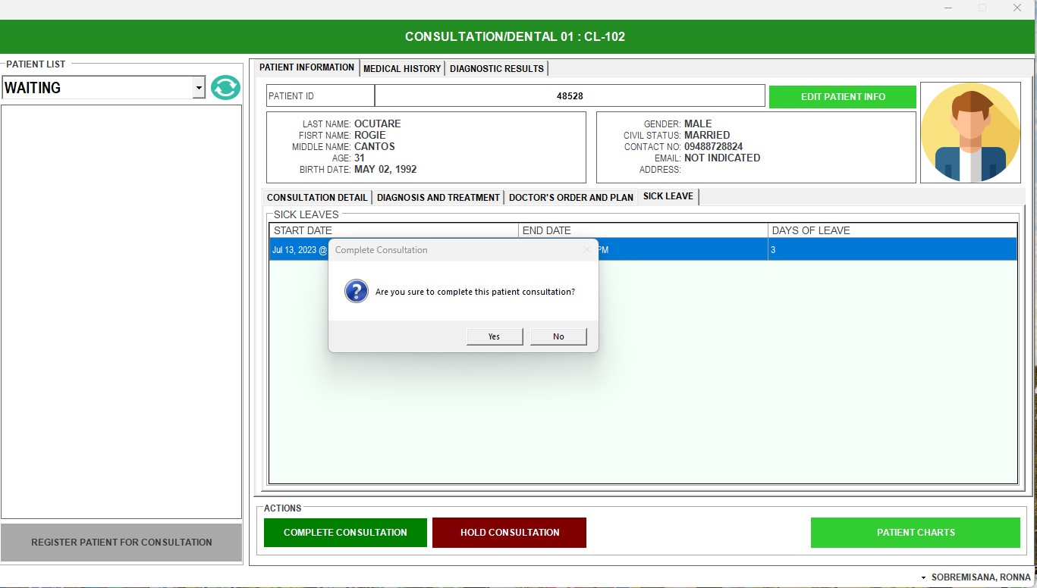
CLICK YES, IF COMPLETED TRANSACTION

Slide 46
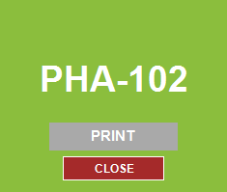
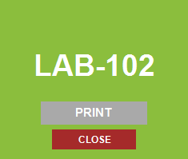
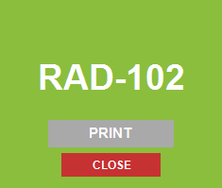
THEN QMS WILL GENERATE NUMBER FOR THE NEXT TRANSACTION
FOR PHARMACY
FOR LAB
FOR LAB
NOTE: IF THERE ARE REQUEST FOR DIAGNOSTICS, MULTIPLE GENERATION OF PRINTED NUMBER WILL APPEAR. THEN THE DOCTORS WILL WRITE THE TRANSACTION NUMBER AT THE BACK OF THE PAPER

Slide 47
THEN THE PATIENT WILL GO TO DIAGNOSTICS ENCODER TO QUEUE PATIENT TO LABARATORY & RADIOLOGY.

Slide 48
PHARMACY AREA

Slide 49
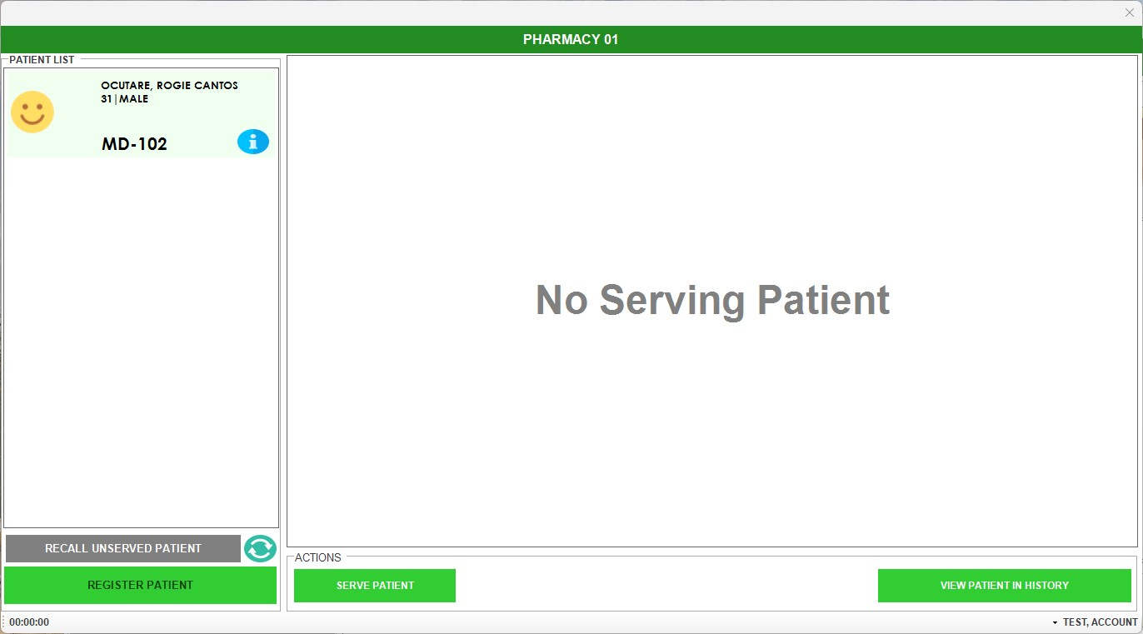
PHARMACY WILL SEE THE PATIENT LIST THEN CLICK SERVE PATIENT

Slide 50
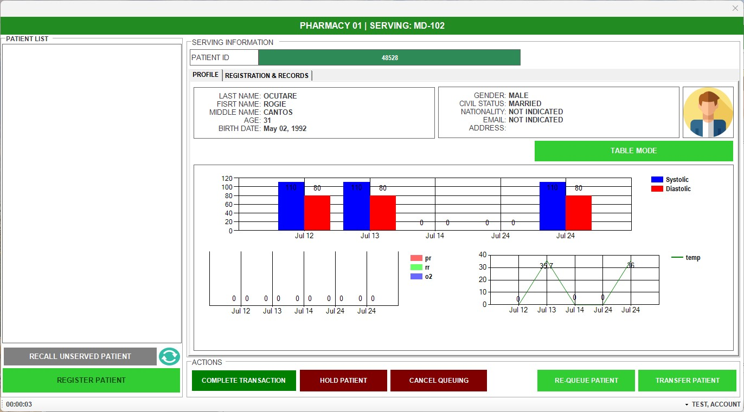
PHARMACY WILL CLICK REGISTRATION & RECORDS

Slide 51
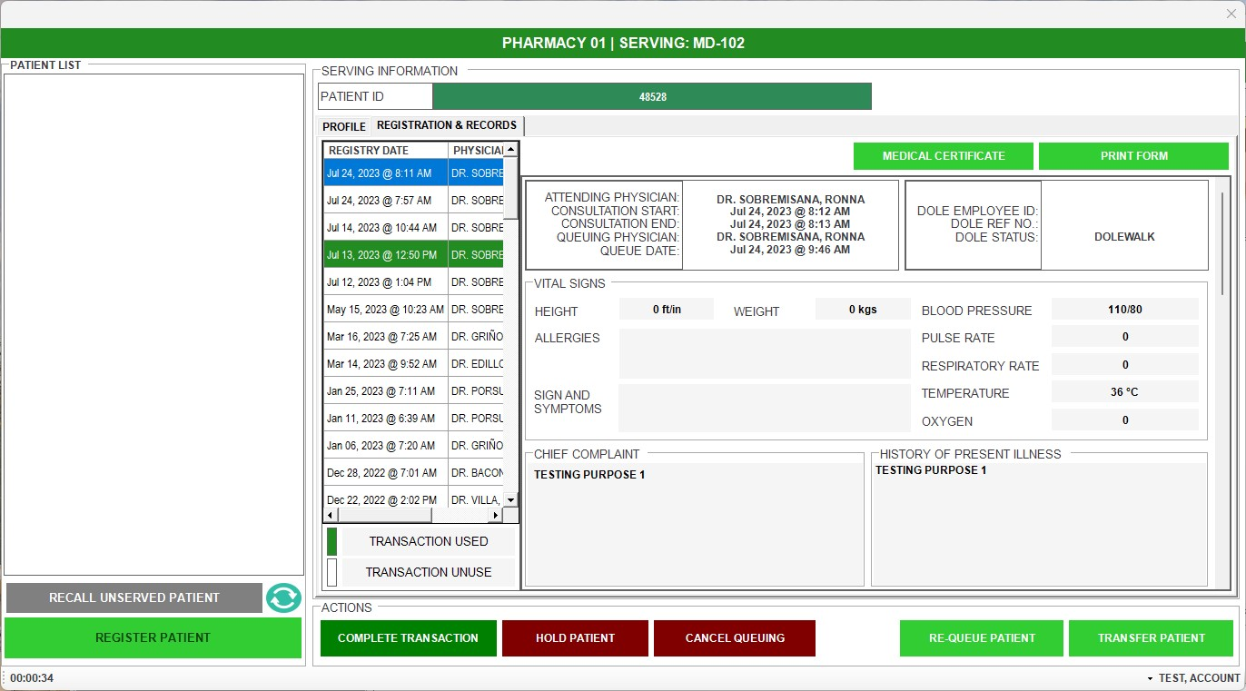
PHARMACY WILL THEN CLICK THE PRESENT DATE & PRINT FORM

Slide 52
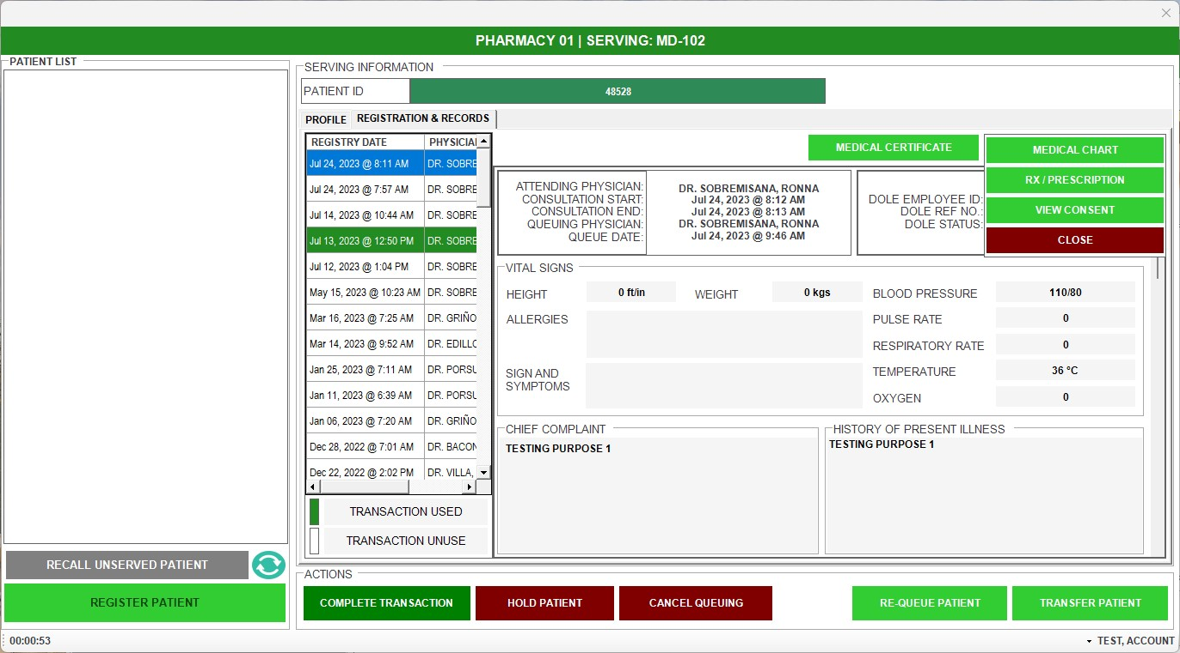
PHARMACY WILL THEN CLICK RX / PRESCRIPTION

Slide 53
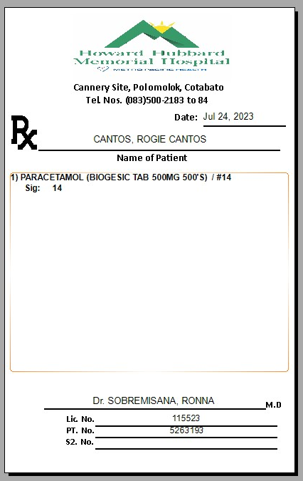
QMS WILL THEN GENERATE THE PRESCRIPTION

Slide 54
LABORATORY AREA

Slide 55
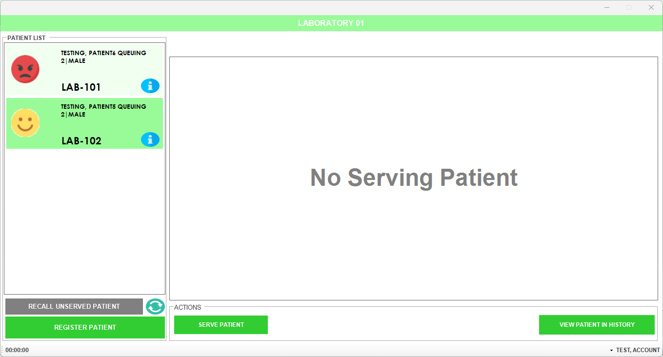

Slide 56

LABORATORY AREA

Slide 57
AFTER COLLECTING THE SPECIMEN CLICK COMPLETE TRANSACTION AND PROCEED TO THE NEXT CLIENT.

Slide 58
RADIOLOGY AREA

Slide 59

LABORATORY AREA

Slide 60

LABORATORY AREA

